Slide 1
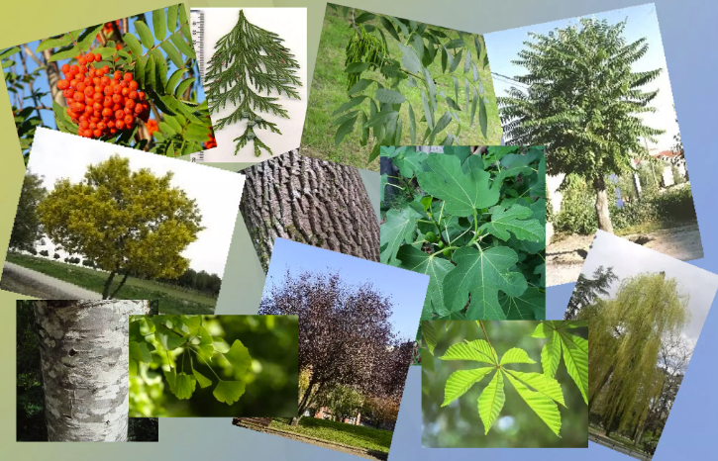
Project: Tree Species Classification
Why?
Knowledge of tree species distribution provides benefits for forest management practices and decision making for site-adapted tree species selection
An accurate assignment of tree species in relation to their location allows conclusions about potential resilience or vulnerability to biotic and abiotic factors
Identifying areas at risk helps the long-term strategy of forest conversion towards a natural, diverse, and climate-resilient forest
How?
Optical remote sensing data + Machine learning

Slide 2
Project Details (1)
Project tasks:
Use Sentinel-2 multi-spectral imagery to derive the dominant tree species for forests in Germany
Dominant tree species shall be classified by a machine-learning approach trained through the provided reference data
Group project (Groups with 4-5 persons each)
A competition!
We shall provide the test data in the last week to evaluate which group’s trained model generalize well on unseen test data
Project deliverable:
Project report (up to 9 pages) explaining the steps used to create the dataset, data augmentation, model training strategy, and hyperparameter tuning details (report to be shared by 15th July 2026, 23:55 hours).
Project presentations on 17th July 2026.
Make sure to include the results on the shared test data in both final report and presentation.

Slide 3
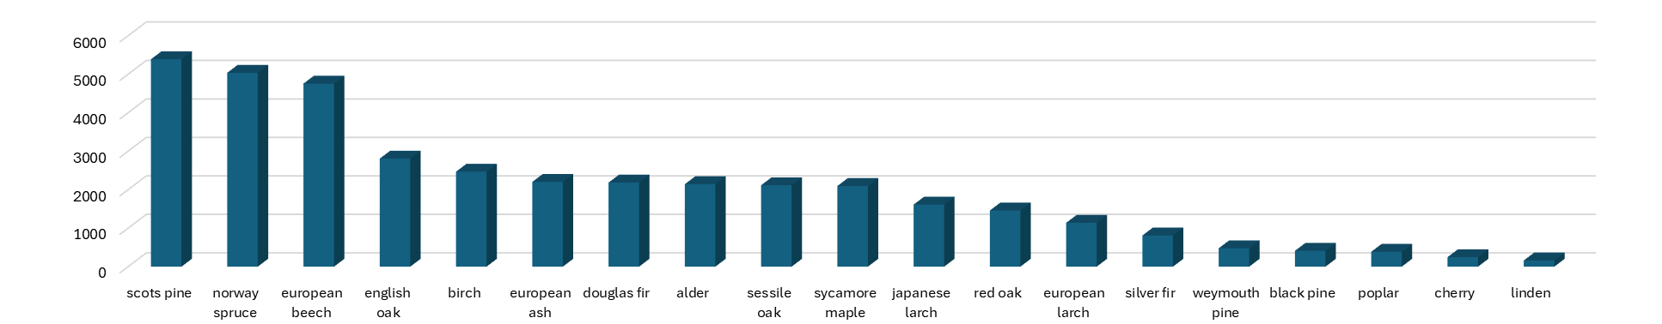
Project Details (2)
Reference Data:
The tree species data of TreeSatAI (Steve et al., 2022) is used as the reference data, which contains a total of 19 trees species and 37,907 sample points. The tree species count is shown as follows:
Ahlswede, Steve, et al. "TreeSatAI Benchmark Archive: A multi-sensor, multi-label dataset for tree species classification in remote sensing." Earth System Science Data Discussions 2022 (2022): 1-22.

Slide 4
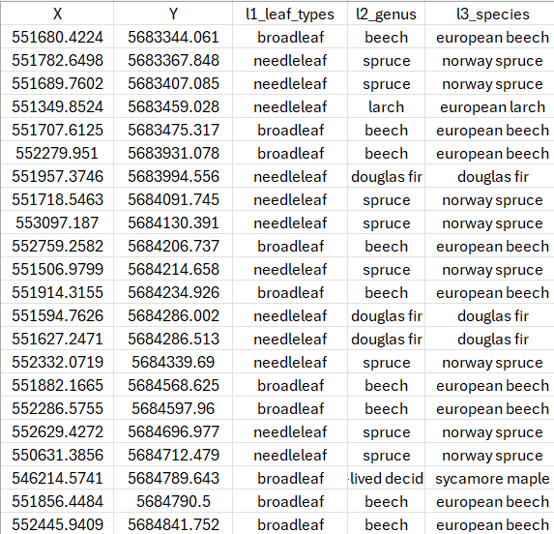
Project Details (3)
Reference Data Format:
TreeSatAI.csv contains the coordinates (X, Y) and the name (l3_species) of tree species.
(X, Y) indicates coordinates of tree species in a ETRS89 / UTM zone 32N reference coordinate system (EPSG:25832)
Except level3 species labels (l3_species), each sample record also contains level2 genus labels (l2_genus) and level1 leaf type labels (l1_leaf_types)

Slide 5
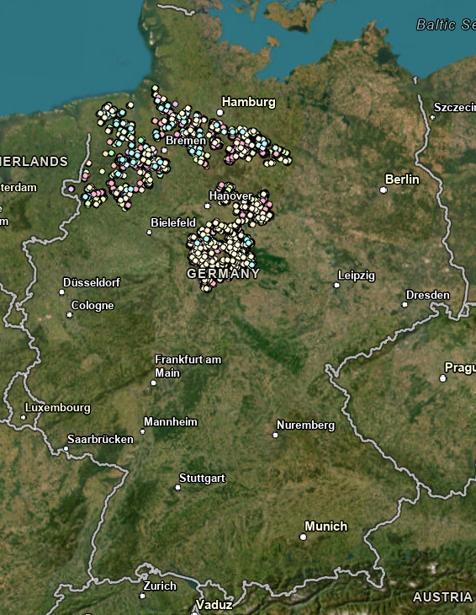
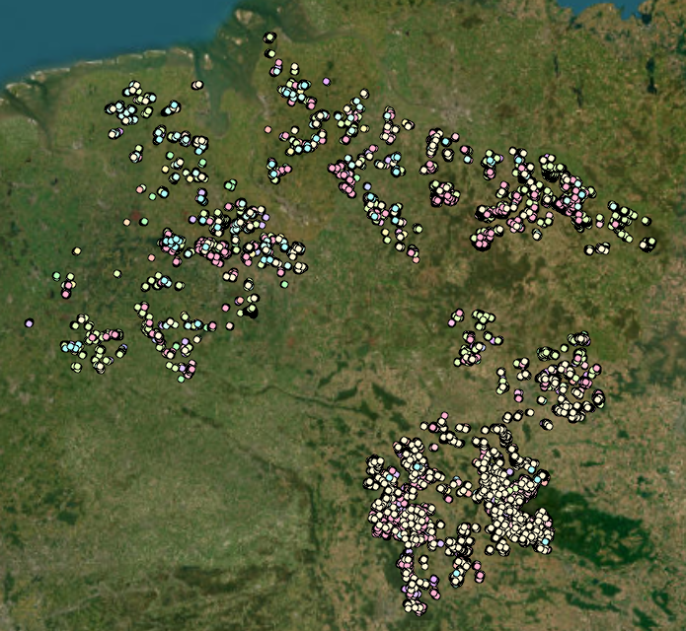
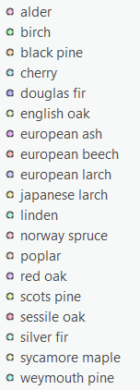
Project Details (4)
Reference Data Visualization:
Fig: Visualization of “TreeSatAI” dataset

Slide 6

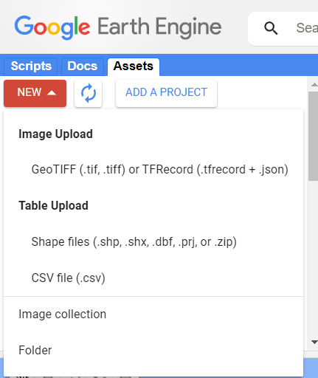
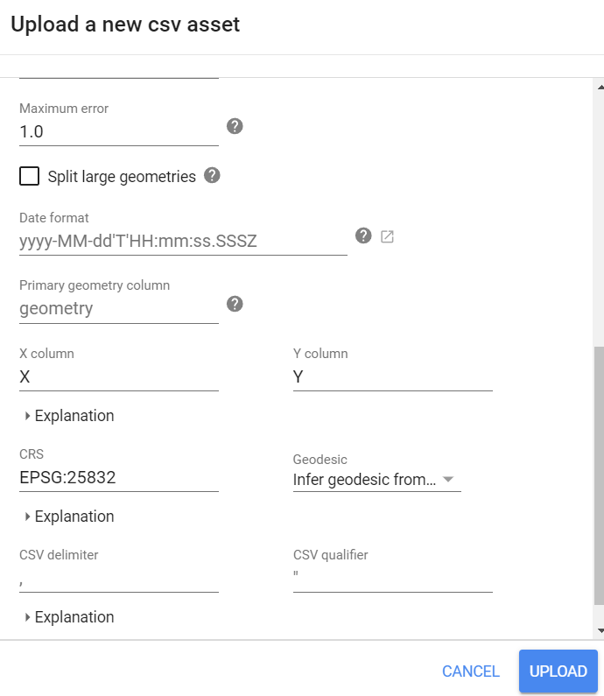
Project Details (5)
Satellite Data Acquisition:
Download the Sentinel-2 data using
Example illustration to download the data:
Upload “TreeSatAI.csv” to Google Earth Engine

Slide 7
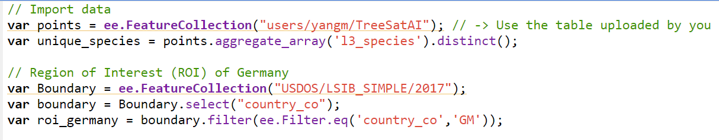
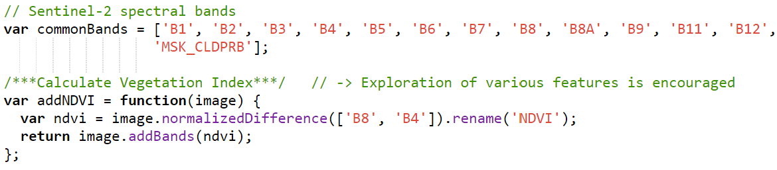
Project Details (5)
Satellite Data Acquisition:
Code demo to download the Sentinel-2 data:
Import data and select the Region-Of-Interest (ROI)
Define the feature combination
Link for the code:
https://code.earthengine.google.com/8def80c3a1576bcf1e44f8f0cd19ba9b

Slide 8
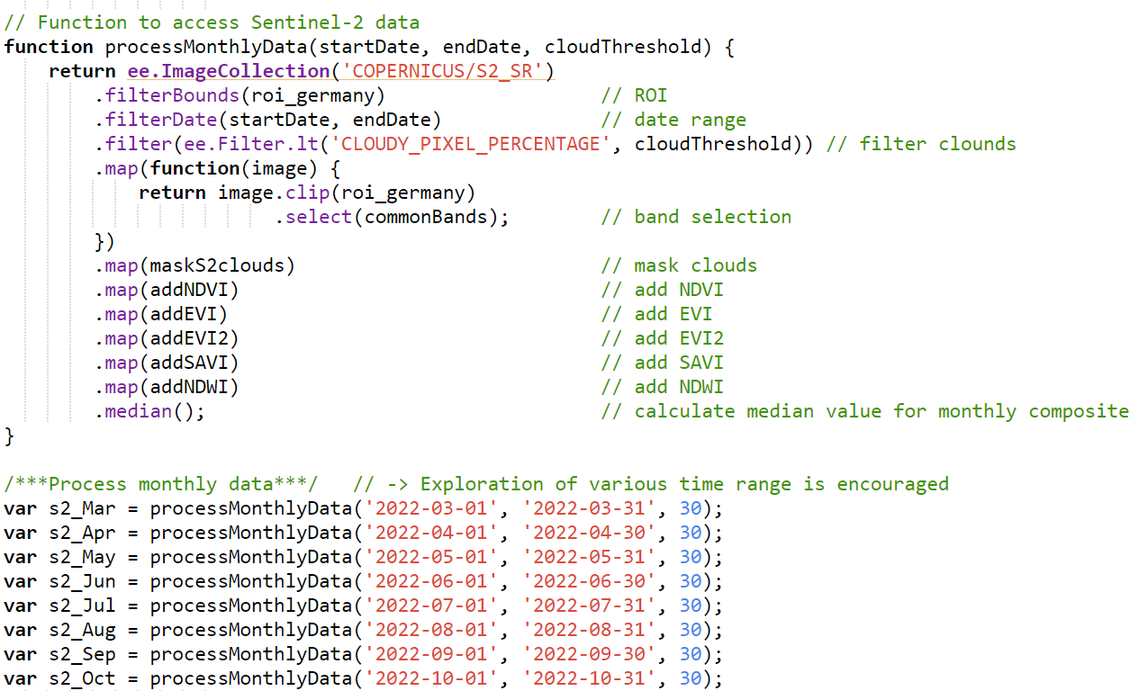
Project Details (5)
Satellite Data Acquisition:
Code demo to download the Sentinel-2 data:
Import data and select the Region-Of-Interest (ROI)
Define the feature combination
Access Sentinel-2 data
The 10 spectral bands and 5 vegetation
bands are selected as feature combination
Images are grouped monthly throughout
the tree growing season (Mar. – Oct. 2022)
Each sample contains (num_month *
(10+5)) feature channels

Slide 9
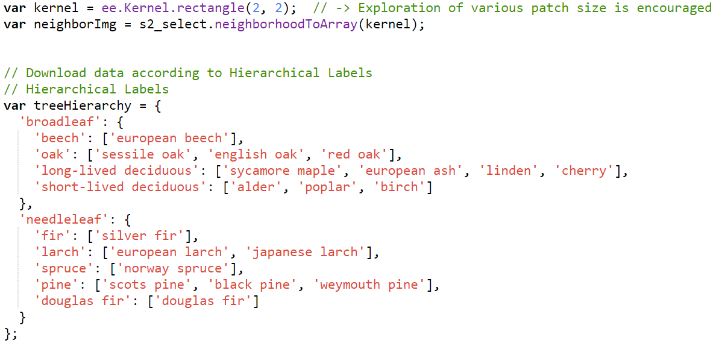
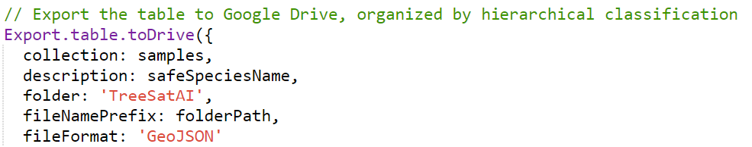
Project Details (5)
Satellite Data Acquisition:
Code demo to download the Sentinel-2 data:
Import data and select the Region-Of-Interest (ROI)
Define the feature combination
Access Sentinel-2 data
Data export
Kernel was used to clip the data patch to 5*5 pixels
All the data patches of different species are exported to Google drive folder as Geojson files
2 pixels
2 pixels
Sample point

Slide 10
Project Details (6)
Basic requirements
Classify the 19 tree species with developed deep learning models
The test dataset (csv file) will be released before the end of project for accuracy assessment
Bonus
Utilize hierarchical labels to address data imbalance and potentially improve classification accuracy (Ozgur et al., 2021)
Exploration of different input data
Different feature combinations (only spectral bands, spectral + vegetation indices, spectral + DEM, spectral + vegetation indices + DEM, etc)
Different patch sizes (1*1, 5*5, 9*9, 13*13 pixels, etc)
Different time range (Mar. – Oct. 2022, all months of 2022, etc)
Exploration of different deep learning models
Traditional: Random Forest, XGBoost, etc
CNN-based, RNN-based, Transformer-based, etc
Turkoglu, Mehmet Ozgur, et al. "Crop mapping from image time series: Deep learning with multi-scale label hierarchies." Remote Sensing of Environment 264 (2021): 112603.

Slide 11
Project Details (7)
Computing Resources:
Link to the wiki https://gitlab.lrz.de/groups/rs-seminar/-/wikis/home
Get credentials by contacting Mr. Ivica Obadic ivica.obadic@tum.de

Slide 12
Questions ?
Please contact us if you have any questions:
Yang Mu
PhD student at the International AI Future Lab: AI4EO, TUM
Email: yang.mu@tum.de

